Slide 1
AN EFFICIENT AND PRIVACY PRESERVING MULTI-KEYWORD SEARCH OVER ENCRYPTED CLOUD DATA
PRESENTED BY:
PRIYATHA JOJI ABRAHAM
TINA PHILIP

Slide 2
AGENDA
Background
System Model & Threat Model
MRSE Framework & MRSE Schemes
Performance Benefits
Current Industry practice & Related Works
Challenges & Improvements to Existing System
Future work & Conclusion

Slide 3

BACKGROUND
Need of Data Privacy and Encryption
Multi-keyword Ranked Search
Meet the Privacy requirements
Current similarity measures chosen

Slide 4
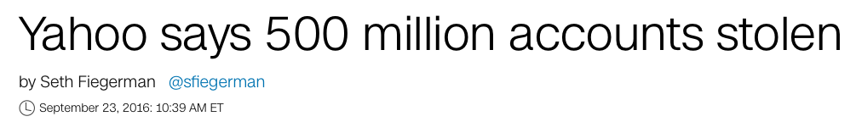
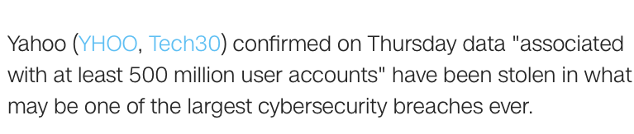
BACKGROUND
Data Breach is a Serious Issue !!

Slide 5
BACKGROUND
Need of Data Privacy and Encryption
Multi-keyword Ranked Search
Meet the Privacy requirements
Current similarity measures chosen i) Coordinate matching - as many matches as possible ii) Inner product similarity - no. of query keywords appearing in a document

Slide 6
PROBLEM FORMULATION
System model
Threat model
Known Ciphertext Model
Known Background Model

Slide 7
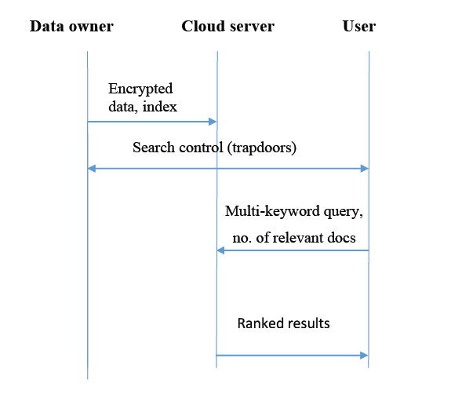
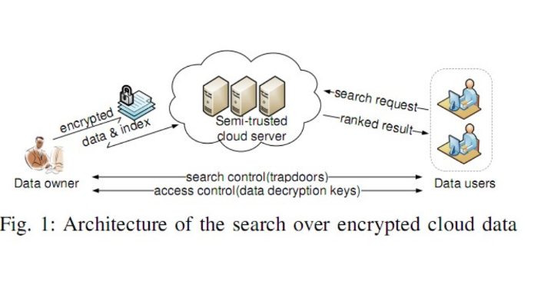
SYSTEM MODEL
[1]

Slide 8

THREAT MODEL
1. Known Cipher-text Model 2. Known Background Model
Know the encrypted dataset from owner Know the encrypted dataset from owner
Searchable index outsource from owner Searchable index from owner Some background of the dataset – trapdoor correlation

Slide 9
MRSE FRAMEWORK
Setup
($I^{l}$)
Setup
(𝐼^𝑙)
BuildIndex (F, SK)
Trapdoor
(T𝒲 ̃ )
Query
(T𝒲 ̃, k, I)

Slide 10
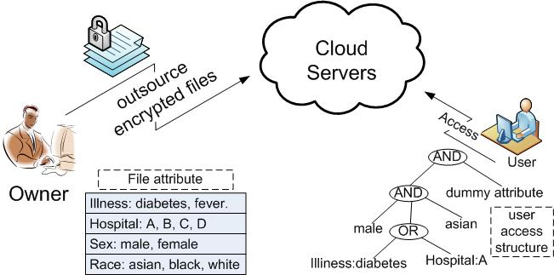

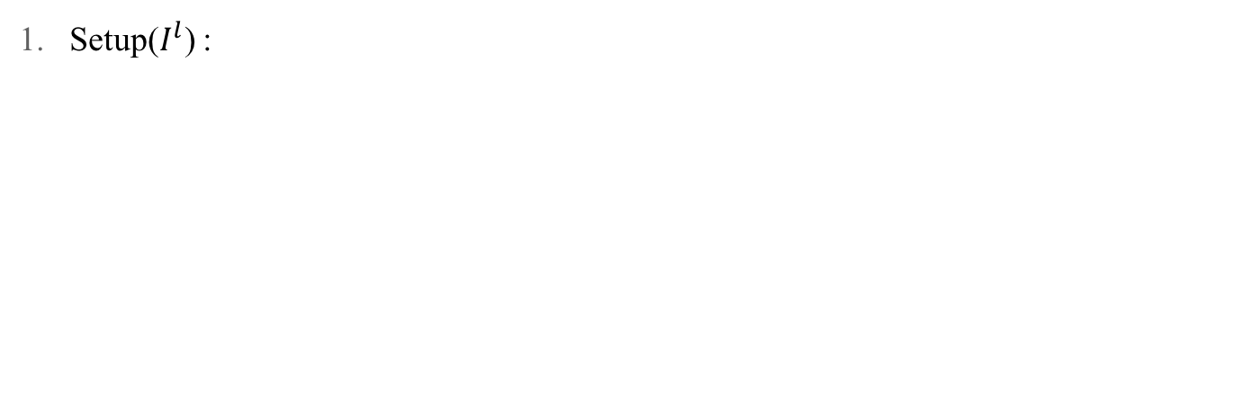
MRSE FRAMEWORK
Setup($I^{l}$) :
Data Owner
Symmetric Key

Slide 11


MRSE FRAMEWORK
2. BuildIndex (F, SK)
Searchable encrypted index
Data Owner
Cloud server

Slide 12

MRSE FRAMEWORK
3. Trapdoor T𝒲 ̃
Request trapdoor
Data Owner
User

Slide 13

MRSE FRAMEWORK
3. Trapdoor T𝒲 ̃
Grant trapdoor
Data Owner
AuthenticatedUser

Slide 14

MRSE FRAMEWORK
4. Query(T𝒲 ̃, k, I)
Black elephant
Valid user provide query and trapdoor
Searchable
encrypted index
Cloud server

Slide 15

MRSE FRAMEWORK
4. Query(T𝒲 ̃, k, I)
Result set returned to valid user
Searchable
encrypted index
Cloud server

Slide 16
PRIVACY REQUIREMENTS
Data Privacy
Index Privacy
Keyword Privacy
Trapdoor Unlink-ability
Access Pattern

Slide 17
MRSE SCHEMES
MRSE I : Privacy-Preserving Scheme in Known Cipher-text Model
MRSE II : Privacy-Preserving Scheme in Known Background Model

Slide 18
MRSE I : Privacy-Preserving Scheme in Known Cipher-text Model
Di is a binary data vector for document Fi
Q is a binary input query vector
Assign Randomness to binary query vector Q[j] ∈ {0,1}
Assign Randomness to binary data vector Di[j] ∈ {0,1}
– insert dummy keyword

Slide 19
MRSE I : Privacy-Preserving Scheme in Known Cipher-text Model
1. Setup
Data owner generate Split vector S and 2 invertible matrices {M1, M2}
Secret key = {S, M1, M2}
2. BuildIndex (F, SK):
Build sub index for encrypted document C
3. Trapdoor T𝒲 ̃
Trapdoor generated for distinct search query keywords Qj
Q is scaled to (rQ,r,t) - random number r ≠ 0
4. Query (T𝒲 ̃, k, I )
User issues query
Provide trapdoor T𝒲
Top -k retrieved
Ranked search on index I

Slide 20
MRSE I : Privacy-Preserving Scheme in Known Cipher-text Model
Different trapdoor generated for “Arabian night” in two searches
Nondeterministic trapdoor generation
Guarantee Trapdoor unlink-ability

Slide 21


COMPARISONS- MRSE I AND MRSE II
MRSE I MRSE II
Keyword privacy not guaranteed Keyword Privacy guaranteed
Little background information is learnt Secure against scale analysis attack

Slide 22
MRSE II : Privacy-Preserving Scheme in Known Background Model
Assign Randomness to query vector
Assign more randomness to data vector – insert more dummy keywords, say U

Slide 23
MRSE II: Privacy-Preserving Scheme in Known Background Model
1. Setup
Data owner randomly generate Split vector S and 2 invertible matrices {M1, M2} – increased size
Secret key = {S, M1, M2}
2. BuildIndex (F, SK):
Build index for encrypted document
3. Trapdoor T𝒲 ̃
Random selection of V out of U dummy keywords
Corresponding entries in Q=1
4. Query (T𝒲 ̃, k, I )
User issues query
Provide trapdoor T𝒲
Top -k returned to user
Ranked search on index I
Notes:
Increased size : (n+U+1) -> U dummy keywords

Slide 24
PERFORMANCE BENEFITS OF EXISTING SYSTEM
Precision and privacy-preserving
High efficiency - Low overhead on computation and communication
Secure against attacks

Slide 25

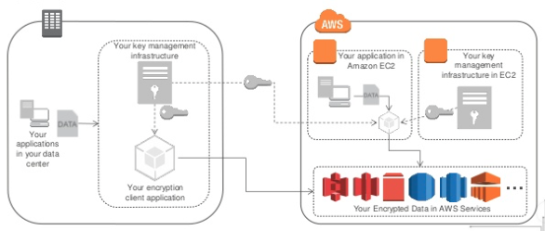
CURRENT INDUSTRY PRACTICE : AWS ENCRYPTION
CLIENT SIDE ENCRYPTION
You encrypt your own data and manage your own keys. a) Supply client-side master keys b) Use AWS KMS- managed customer master key
[5]
Notes:
Encrypt data before submitting to Amazon S3. a) Supply client-side master keys

Slide 26
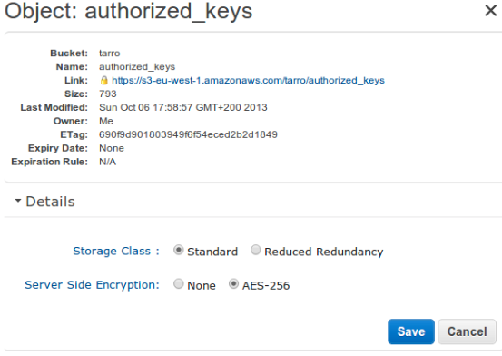
CURRENT INDUSTRY PRACTICE : AWS ENCRYPTION
SERVER SIDE ENCRYPTION
AWS encrypts data (AES 256-bit) and manage keys with a) Amazon S3-Managed Keys b) AWS KMS-Managed Keys (SSE-KMS)
[5]
Notes:
You request Amazon S3 to encrypt your object before saving it on disks in its data centers and decrypt it when you download the objects

Slide 27

CURRENT INDUSTRY PRACTICE : AMAZON CLOUDSEARCH
Create search domain
Upload documents JSON or XML
Issue search query
Search parameters provided by user – Field weight, Autocomplete suggestion, Boolean search, Geos

Slide 28
RELATED WORKS
Single keyword searchable encryption eg: “GALAXY”
Boolean keyword searchable encryption eg: “SAMSUNG AND GALAXY” / “SAMSUNG OR GALAXY”
“GALAXY”
Galaxy bioinformatics
Galaxy–stars wiki
Samsung galaxy
Results
Samsung galaxy S7 edge
Samsung galaxy cell phones
“SAMSUNG GALAXY ”
Results

Slide 29
MAJOR ISSUES OF EXISTING SYSTEM
Only exact keyword matches returned
Identity privacy of user unprotected
Not designed to protect the access pattern for efficiency concerns

Slide 30
IMPROVEMENTS
EXISTING | ENHANCED
1. No human errors tolerated | 1. Human errors tolerated, approx. string matching.
2. Relevance ranking | 2. Relevance ranking based on Ngram, where gram size =3
3. No user id protection from data-owner | 3. Identity protection of user by encryption
4. Trapdoor granted by owners to valid users | 4. Grant or revoke trapdoor facility to valid users.
5. Files and index uploaded to same cloud server | 5. Files and index outsourced to different cloud servers for added security.

Slide 31



ENHANCED SYSTEM ARCHITECTURE
Encrypted files
Cloud Server
Blak olephan
Data owner
+
Encrypted index
( top-5 )
Amazon RDS

Slide 32
ENHANCED SYSTEM ARCHITECTURE
Encrypted files
Retrieve files (E)
Cloud Server
Req. received
Blak olephan
Data owner
Valid user
+
Ngram search
Encrypted index
Amazon RDS
( top-5 )

Slide 33
ENHANCED SYSTEM ARCHITECTURE
Decrypted top-k ranked results returned to user
Data owner
Valid user

Slide 34
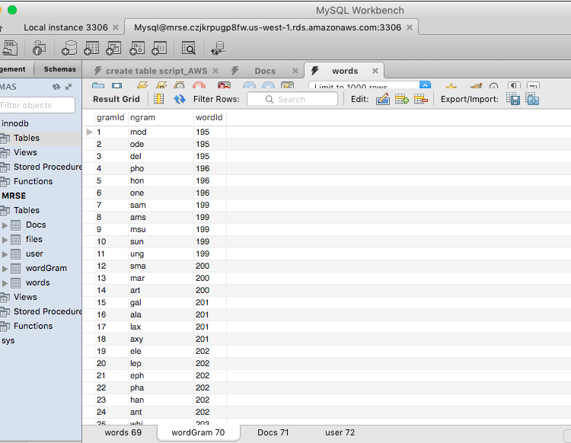

MORE ABOUT ENHANCED SYSTEM
Efficient ranked search for multi-keyword queries - Ngram approximate string matching
Preserves privacy of data - File encryption - AES 128-Bit encryption - Index encryption - SHA1 Hashing algorithm
Searchable encrypted files and index - Encrypted files at Drop box - Index at Amazon RDS – MySQL instances
Protect identity/privacy of user

Slide 35
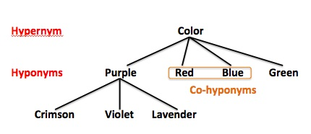
FUTURE WORK
Hypernym, hyponym based searching with less search - time complexity.
Place encrypted index on multiple clouds for more protection.

Slide 36
CONCLUSION
In existing system: - Solves the problem of multi-keyword ranked search over encrypted cloud data - Establishes privacy requirements using 2 MRSE schemes
In enhanced system: - Search result time depends on query word & dataset. - single or multi keyword (34 ms – 545 ms)

Slide 37
REFERENCES
[1] C. Wang, K. Ren, M. Li, N. Cao, and W. Lou “Privacy-Preserving Multi-Keyword Ranked Search over Encrypted Cloud Data,” IEEE Transactions on Parallel and Distributed Systems, 2014 Available: http://ieeexplore.ieee.org.libaccess.sjlibrary.org/stamp/stamp.jsp?arnumber=66749 [2] J. Wu, S. Xiao, and S. Zhou, W. Zhang and Y. Lin , “Privacy Preserving Ranked Multi-Keyword Search for Multiple Data Owners in Cloud Computing,” IEEE Transaction on Computers, 2016 Available: http://ieeexplore.ieee.org.libaccess.sjlibrary.org/stamp/stamp.jsp?arnumber=7130597 [3] K. H. Ho and T. S. Moh "Efficient semantic search over encrypted data in cloud computing," International Conference on High Performance Computing & Simulation (HPCS), 2014 Available: http://ieeexplore.ieee.org/stamp/stamp.jsp?tp=&arnumber=6903711&isnumber=6903651 [4] L. Chen, Q. Liu , X. Sun and Z. Xia “An Efficient and Privacy-Preserving Semantic Multi-Keyword Ranked Search over Encrypted Cloud Data,” International Journal of Security and Its Applications, 2014 Available: http://dx.doi.org/10.14257/astl.2013.31.58 [5] Jason Chan, Ken Beer and Todd Cignetti “Encryption and key management in AWS”, Docs.aws.amazon.com, 2013. [Online]. Available: http://www.slideshare.net/AmazonWebServices/encryption-and-key-management-in-aws-sec304-aws-reinvent-2013 [6] “Protecting Data Using Encryption”, Docs.aws.amazon.com, 2016. [Online]. Available: http://docs.aws.amazon.com/AmazonS3/latest/dev/UsingClientSideEncryption.html.

Slide 38


Slide 39

Any Questions ???

